Slide 1

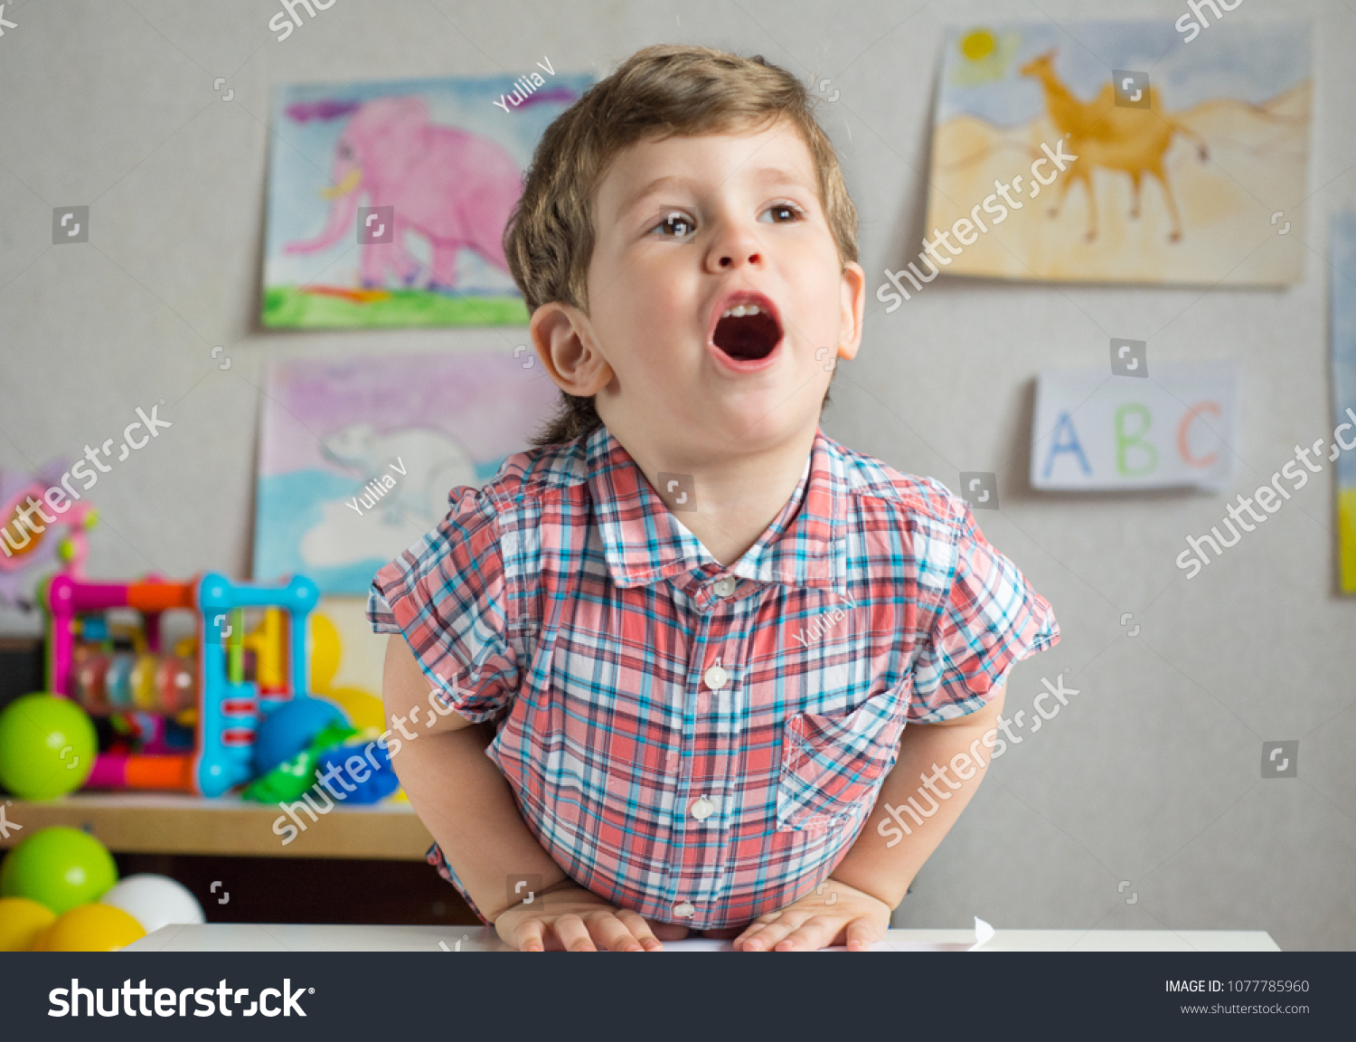
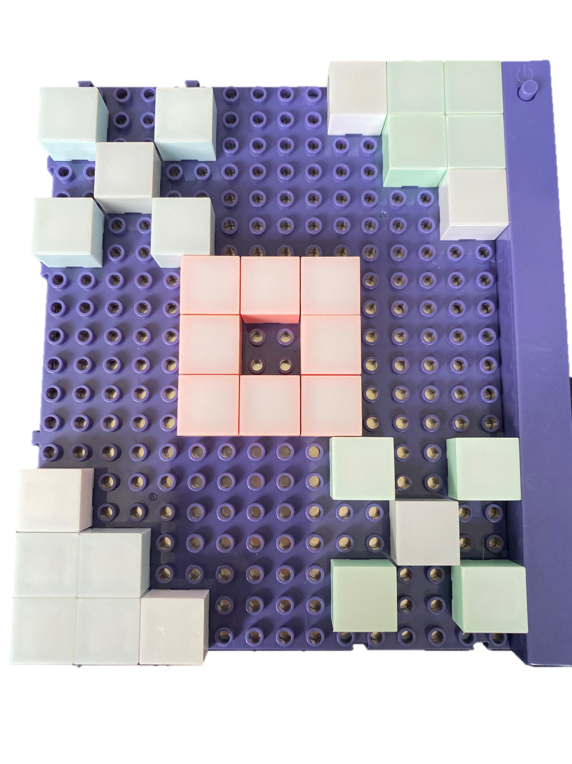
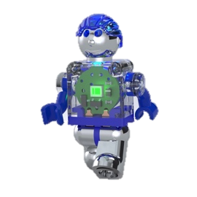
E-Blox Student/Teacher Guide
Lite Blox
Pre-K: Early Learning
Seymour Says: E-Blox are STEMsational!!!
BUILD IT POWER IT LEARN IT
Copyright © 2020 E-Blox®, Inc. All rights reserved.

Slide 2

How to Use this Curriculum
This Curriculum has 5 lessons that teach early learning
It is recommended that the Lessons be taught in order, but can be taught in any order at the preference of the instructor.
This Curriculum can be viewed or presented in any of the following manners:
  If viewing on PC with Windows PowerPoint
    Make sure you clicked the link for PowerPoint Format (PowerPoint - E-Blox Circuit Blox 59 Student Guide.pptx)
    Make sure to be in Slide Show mode when viewing/presenting
  If viewing on Android, iOS or Chromebook device using Google Sheets
    Make sure you clicked the link for Google Slides Format (Google Slides - E-Blox Circuit Blox 59 Student Guide)
    Make sure to hit Present or the Play Arrow ( )
  If no computer/device or internet is available
    Lessons can be printed and handed out to students
  The Lessons provide sample builds for the students to make of letters, numbers, shapes and objects for early learning.

Slide 3
Table of Contents
Setup
Curriculum Lessons
  Lesson 1 – Letters
  Lesson 2 – Numbers
  Lesson 3 – Colors
  Lesson 4 – Shapes
  Lesson 5 – Objects

Slide 4
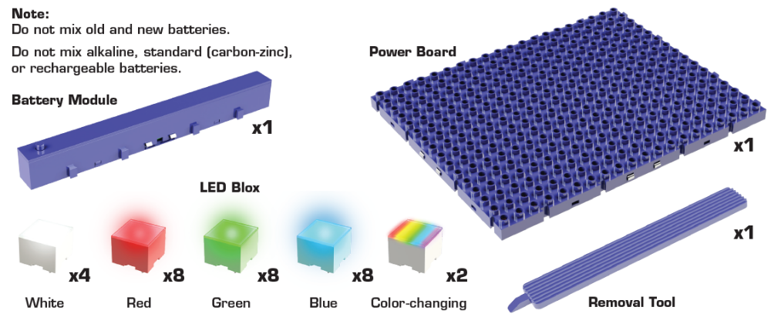
Setup – Component List
The Lite Blox set consists of:
1 Power Board
1 Battery Module
1 Removal Tool
30 LED Blox
Seymour Says: Like A good actor once told me…always know your PARTS!

Slide 5
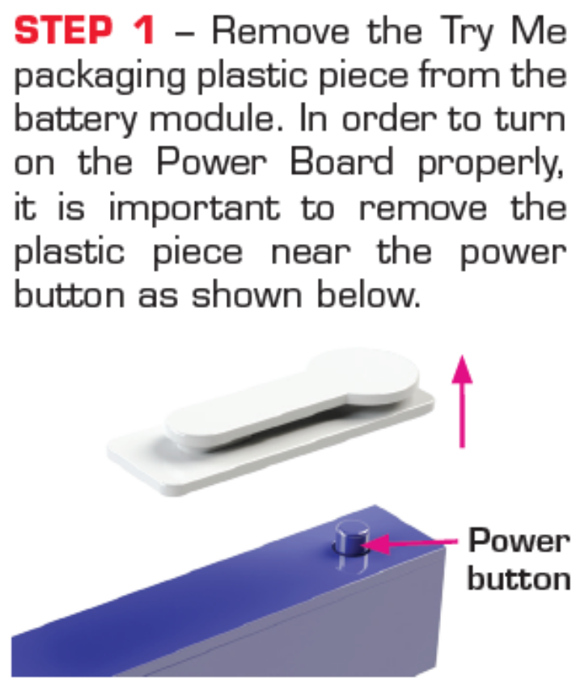
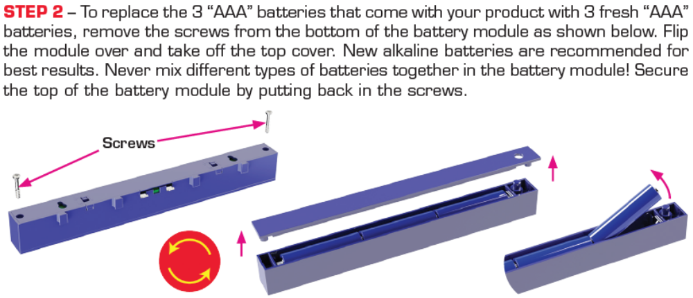
Setup - Battery Module

Slide 6
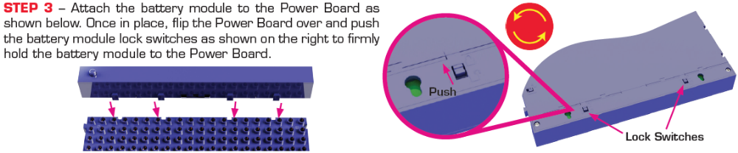
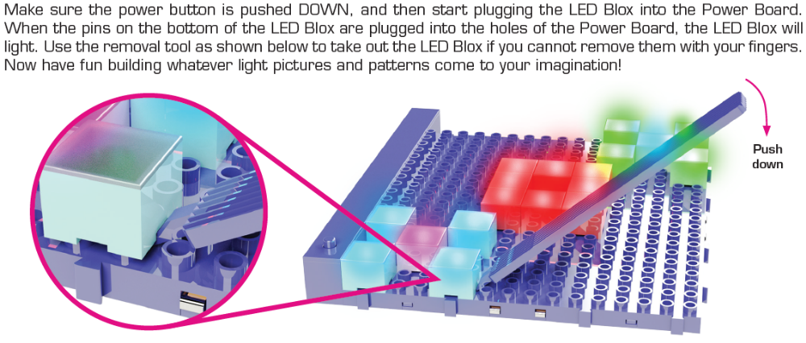
Setup - Power Board Setup

Slide 7
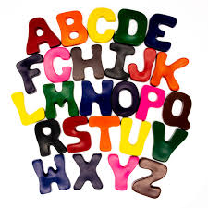
Lesson 1 – Letters
Lesson length: 40 Min (multiple times)
Key Learning: Identify Letters
Seymour Says: I’m only familiar with 25 letters of the alphabet…
I don’t know y!

Slide 8
Letters
Pick a letter from the alphabet
A B C D E F G H I J K L M N O P Q R S T U V W X Y Z
Using the LED Blox, build the letter on the Power Board
Name several things that begin with the letter you built.
Seymour Says: The next several slides provide examples of how to build each letter, and some common things that begin with each letter.

Slide 9
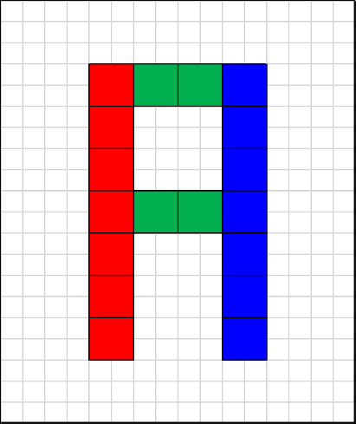


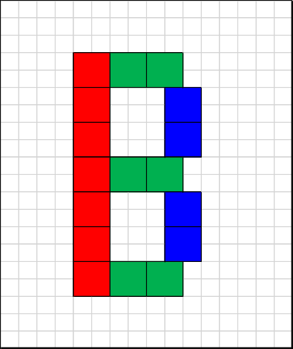
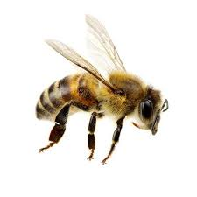
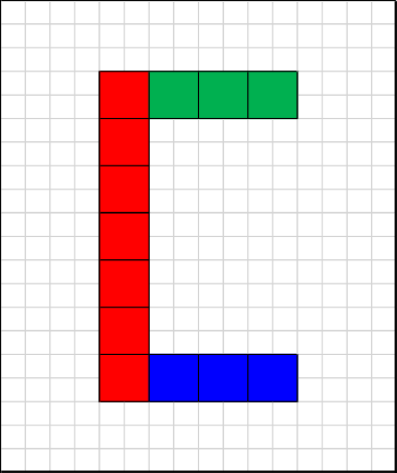
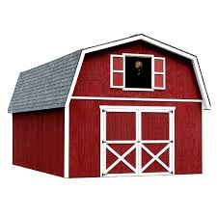


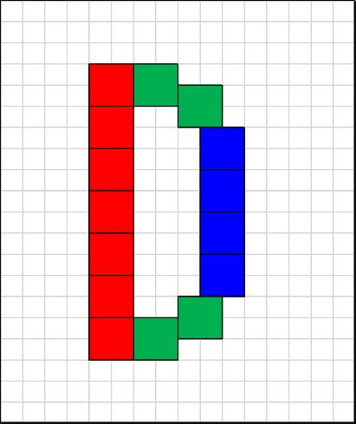
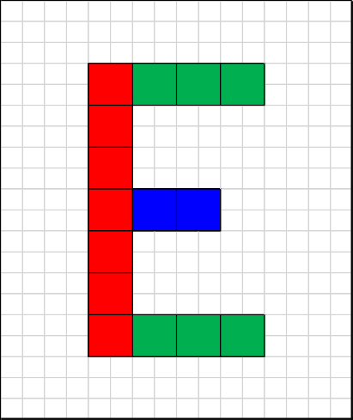
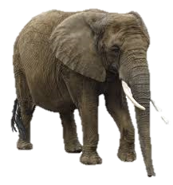
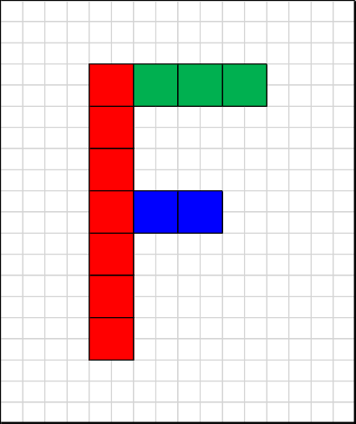

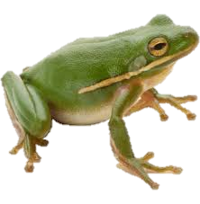

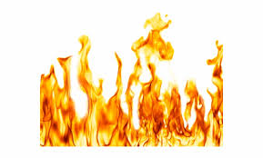

Letters

Slide 10
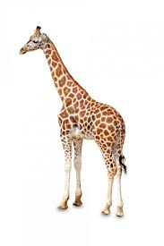
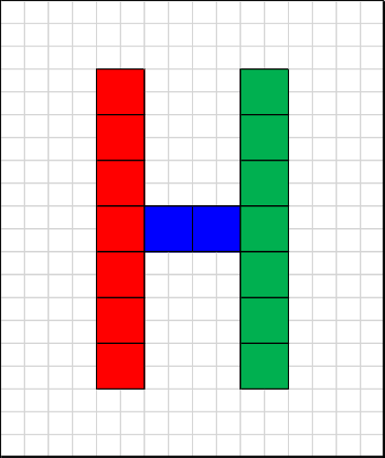
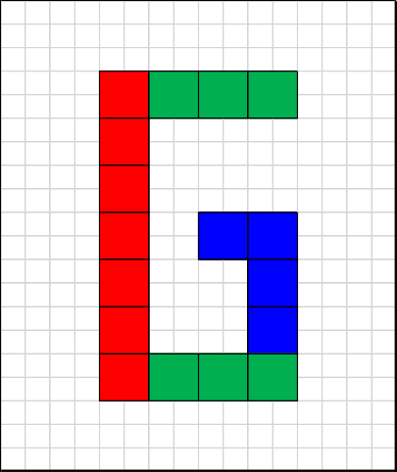

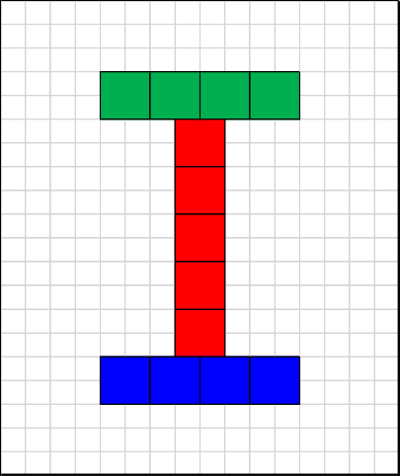

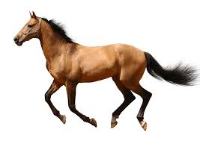


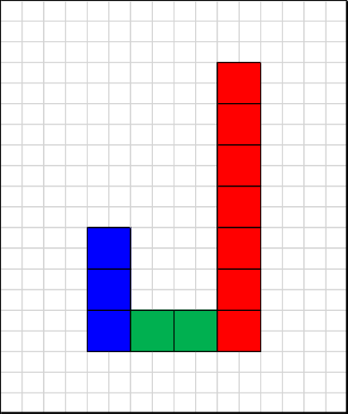
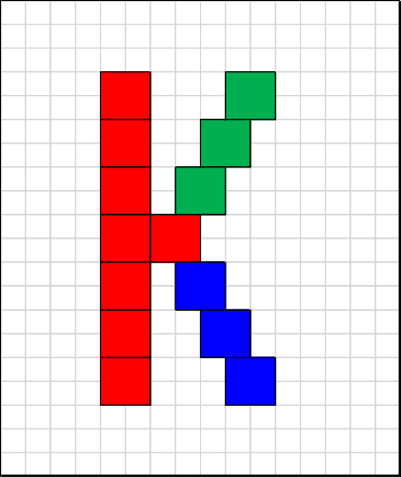

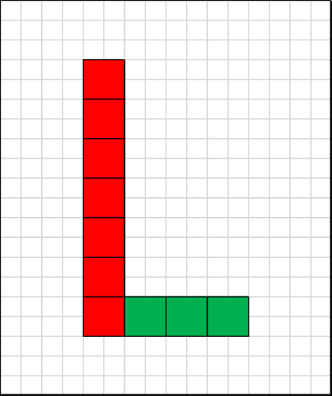
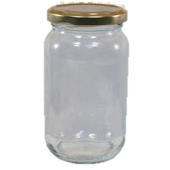
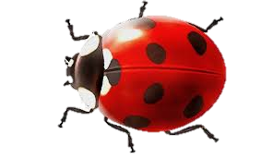
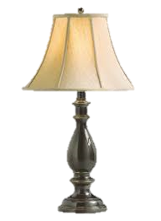
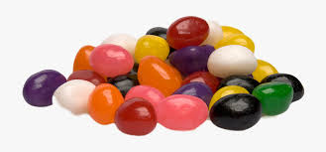
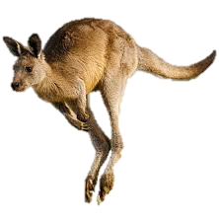
Letters

Slide 11
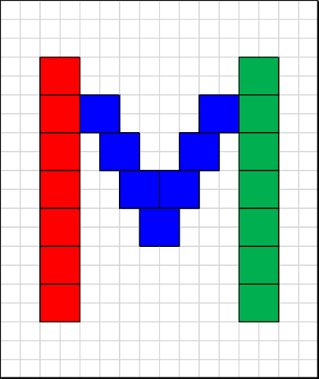
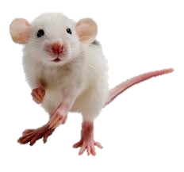
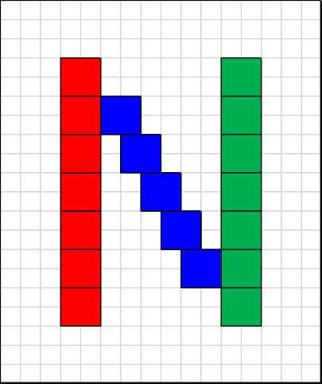
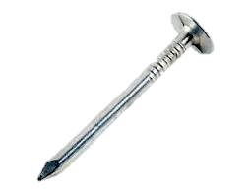
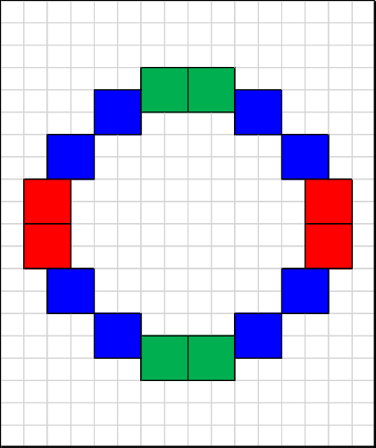



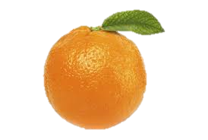
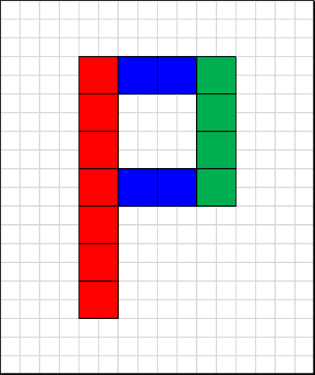

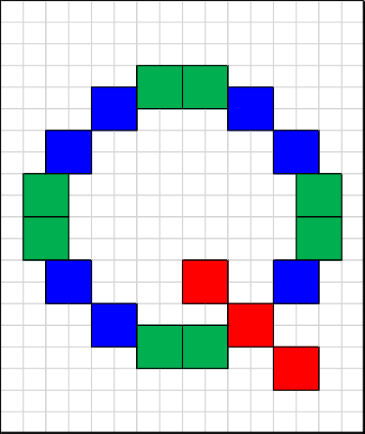
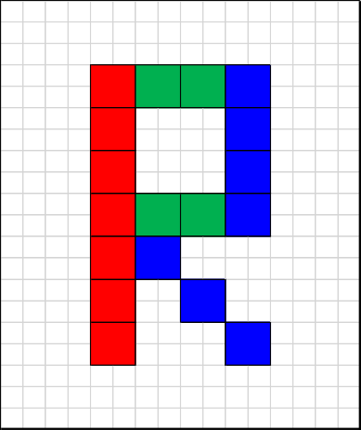


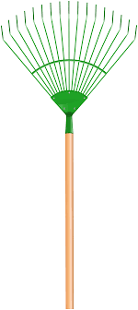
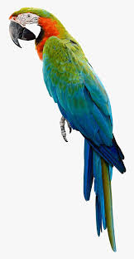
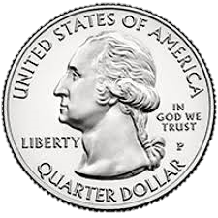
Letters

Slide 12
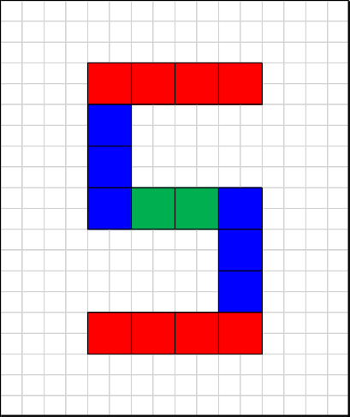

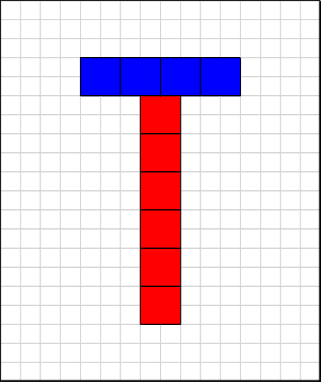
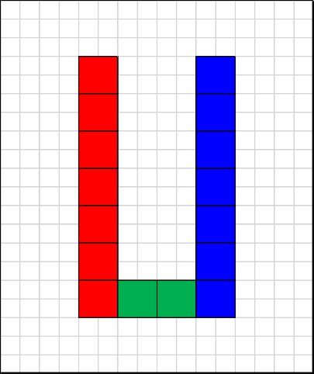
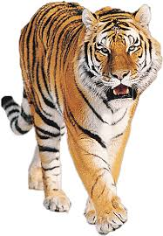

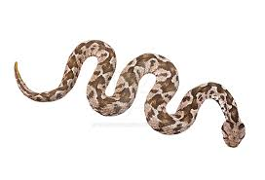











Letters

Slide 13






Letters

Slide 14

Lesson 2 – Numbers
Lesson length: 40 Min (multiple times)
Key Learning: Identify Numbers
Seymour Says: You know what’s odd?
Every other number!

Slide 15
Numbers
Pick a single digit number
1 2 3 4 5 6 7 8 9 0
Using the LED Blox, build the number on the Power Board
Count a number of objects equal to the number you chose
Seymour Says: The next several slides provide examples of how to build each number, and a group of objects that sum to each number.

Slide 16











Numbers

Slide 17








Numbers

Slide 18

Lesson 3 – Colors
Lesson length: 40 Min
Key Learning: Identify Colors
Seymour Says: What color is a window?
I think the answer is pretty clear!

Slide 19
Colors
Pick a Color:
Green, Red, Blue or White
Using the LED Blox, build a shape on the Power Board using only the color you chose
Think of things that are of the color you chose
Seymour Says: The next several slides provide examples of how to build a single color shape, and examples of some objects that are each color.

Slide 20












Colors

Slide 21

Lesson 4 – Shapes
Lesson length: 40 Min (multiple times)
Key Learning: Identify Shapes
Seymour Says: What shape is useless?
A circle…because it’s pointless!

Slide 22
Shapes
Pick a shape:
Square, Rectangle, Triangle or Circle
Using the LED Blox, build the shape on the Power Board
Think of things that are of the shape you built
Seymour Says: The next several slides provide examples of how to build each shape, and examples of some objects that are each shape.

Slide 23












Shapes

Slide 24

Lesson 5 – Objects
Lesson length: 40 Min (multiple times)
Key Learning: Identify Objects
Seymour Says: Why are two-dimensional objects good at cutting down trees?
Because they have two axes!

Slide 25
Objects
Pick an object
Using the LED Blox, try building the object on the Power Board
Find a picture of the object you chose and put it next to what you built to see how similar it looks
Seymour Says: The next several slides provide examples of how to build some objects and pictures of what the objects represent.

Slide 26












Objects

